Slide 1
Object Oriented Programming Using Java
Introduction to Java(part 6)
Prepared by Renetha J.B.
Prepared by Renetha J.B.
1

Slide 2
Topics
Operators –
  Arithmetic Operators,
  Bitwise Operators,
  Relational Operators,
  Boolean Logical Operators,
  Assignment Operator,
  Conditional (Ternary) Operator,
  Operator Precedence.
Prepared by Renetha J.B.
2

Slide 3
Operators
Operators are used for performing operations.
  Arithmetic Operators
    +, -, *, /, % ++, +=, -=,*=, /=, %=, - -
  Bitwise Operators ~ Bitwise unary NOT
    &,| ,^ , >> ,>>> ,<< , &=, |=, ^=, >>=, >>>=
  Relational Operators
    = =, !=, >, < , <=, >=
  Boolean Logical Operators
    &, |, ^, ||,&&, &=,| =, ^=, ==, !=, ?:
  Assignment Operator
    =, +=, -=, *=
  Conditional (Ternary) Operator
  ?:
Prepared by Renetha J.B.
3

Slide 4
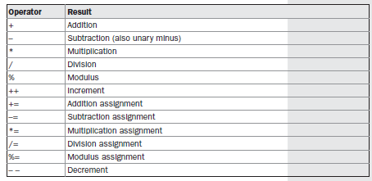
Arithmetic Operators
Prepared by Renetha J.B.
4

Slide 5
class BasicMath {
public static void main(String args[]) {
System.out.println("Integer Arithmetic");
int a = 1 + 1;
int b = a * 3;
int c = b / 4;
int d = c - a;
int e = -d;
System.out.println("a = " + a);
System.out.println("b = " + b);
System.out.println("c = " + c);
System.out.println("d = " + d);
System.out.println("e = " + e);
System.out.println("\nFloating Point Arithmetic");
double da = 1 + 1;
double db = da * 3;
double dc = db / 4;
double dd = dc - a;
double de = -dd;
System.out.println("da = " + da);
System.out.println("db = " + db);
System.out.println("dc = " + dc);
System.out.println("dd = " + dd);
System.out.println("de = " + de);
}
}
Integer Arithmetic
a = 2
b = 6
c = 1
d = -1
e = 1
Floating Point Arithmetic
da = 2.0
db = 6.0
dc = 1.5
dd = -0.5
de = 0.5

Slide 6
The Basic Arithmetic Operators
The basic arithmetic operations—addition, subtraction, multiplication, and division works for all numeric types.
  The minus operator also has a unary form that negates its single operand.
  E.g int a=3;
  int b=-a;
Prepared by Renetha J.B.
6

Slide 7
Modulus Operator
The modulus operator, %, returns the remainder of a division operation.
It can be applied to floating-point types as well as integer types.
42 % 10 = 2
42.25 % 10 = 2.25
Prepared by Renetha J.B.
7

Slide 8
Arithmetic Compound Assignment Operators
Variable operator = expression;
This is same as
  Variable =Variable operator expression;
In programming:
a = a + 4;
can be written as
a += 4;
E.g.
int a=3;
a+=2; //Now value of a is 3+2=5
Prepared by Renetha J.B.
8

Slide 9
// Demonstrate the % operator.
class Modulus {
public static void main(String args[]) {
int x = 42;
double y = 42.25;
System.out.println("x mod 10 = " + x % 10);
System.out.println("y mod 10 = " + y % 10);
}
}
When you run this program, you will get the following output:
x mod 10 = 2
y mod 10 = 2.25
Prepared by Renetha J.B.
9

Slide 10
Pre-Increment Post increment
Pre increment E.g
x = 42;
y = ++x;
Post increment E.g
x = 42;
y = x++;
x 43
y 43
x 43
y 42
Prepared by Renetha J.B.
10

Slide 11
a=3;
b=8;
c=a+++b;
a=3;
b=8;
c=a+++++b;
Here c=a+++b is same as
c=(a++)+b
First a+b is done then it is stored in c then a is incremented.
So values are
a=4
b=8
c=11
Here c=a++++b is same as
c=(a++)+(++b)
First bis incremented, then a+b is done then it is stored in c then a is incremented.
So values are
a=4
b=9
c=12

Slide 12
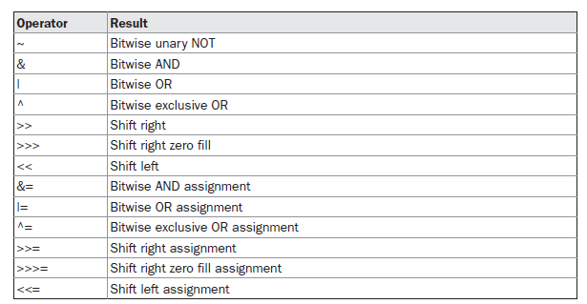
Bitwise operators
Prepared by Renetha J.B.
12

Slide 13
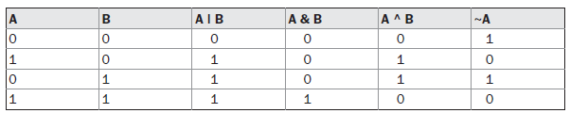
Bitwise logical oprators
Prepared by Renetha J.B.
13

Slide 14




Examples
Prepared by Renetha J.B.
14

Slide 15
class BitLogic {
public static void main(String args[]) {
String binary[] = {"0000", "0001", "0010", "0011", "0100", "0101", "0110"};
int a = 3;
int b = 6;
int c = a | b;
int d = a & b;
int e = a ^ b;
int f = (~a & b) | (a & ~b);
int g = ~a & 0x0f;
System.out.println(" a = " + binary[a]);
System.out.println(" b = " + binary[b]);
System.out.println(" a|b = " + binary[c]);
System.out.println(" a&b = " + binary[d]);
System.out.println(" a^b = " + binary[e]);
System.out.println("~a&b|a&~b = " + binary[f]);
System.out.println(" ~a = " + binary[g]);
} }
OUTPUT
a = 0011
b = 0110
a|b = 0111
a&b = 0010
a^b = 0101
~a&b|a&~b = 0101
~a = 1100
OUTPUT
a = 0011
b = 0110
a|b = 0111
a&b = 0010
a^b = 0101
~a&b|a&~b = 0101
~a = 1100

Slide 16
Left Shift
The left shift operator, <<, shifts all of the bits in a value to the left a specified number of times.
  value << num
For each shift left, the high-order bit(leftmost) is shifted out (and lost), and a zero is brought in on the right.
When a left shift is applied to an int operand, bits are lost once they are shifted past bit position 31.
If the operand is a long, then bits are lost after bit position 63
byte and short values are promoted to int when an expression is evaluated.
  result of a left shift on a byte or short value will be an int, and the bits shifted left will not be lost until they shift past bit position 31.

Slide 17
// Left shifting a byte value.
class ByteShift {
public static void main(String args[]) {
byte a = 64, b;
int i;
i = a << 2;
b = (byte) (a << 2);
System.out.println(" a: " + a);
System.out.println("i and b: " + i + " " + b);
}
}
a: 64
i and b: 256 0
Note:
In the case of i = a << 2;
Since a is promoted to int for the purposes of evaluation, left-shifting the value 64 (0100 0000) twice results in i (i is int) containing the value 256 (1 0000 0000).
But in b = (byte) (a << 2);
a<<2 result is convereted to byte and stored in byte b.
the value in b(b is byte) contains 0 because after the shift, the low-order byte is now zero. Its only 1 bit has been shifted out.

Slide 18

Right shift
Each time you shift a value to the right, it divides that value by two—and discards any remainder.
When you are shifting right, the top (leftmost) bits exposed by the right shift are filled in with the previous contents of the top bit. This is called sign extension and serves to preserve the sign of negative numbers when you shift them right. For example, –8 >> 1 is –4
Prepared by Renetha J.B.
18

Slide 19



Right shift e.g
E.g.
E.g.
Prepared by Renetha J.B.
19

Slide 20

Unsigned, shift-right operator >>>
Shift a zero into the high-order bit(letftmost or top) no matter what its initial value was. This is known as an unsigned shift.
Java’s unsigned, shift-right operator, >>> always shifts zeros into the high-order bit.
E.g a is set to –1, which sets all 32 bits to 1 in binary. This value is then shifted right 24 bits, filling the top 24 bits with zeros, ignoring normal sign extension. This sets a to 255.
Prepared by Renetha J.B.
20

Slide 21
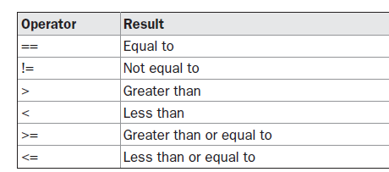
Relational operators
Prepared by Renetha J.B.
21

Slide 22
Relational operator(contd.)
int a = 4;
int b = 1;
boolean c = a < b; //c contains false. 4 is not less than 1
Here the result of a<b (which is false) is stored in c.
E.g.
int done;
// ...
if(!done) ... // Valid in C/C++
if(done) ... // but not valid in Java.
if(done == 0) // This is Java-style.
if(done != 0)
In Java, true and false are nonnumeric values that do not relate to zero or nonzero.
Prepared by Renetha J.B.

Slide 23
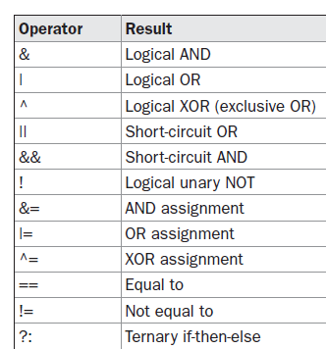
Boolean Logical Operators
Prepared by Renetha J.B.
23

Slide 24
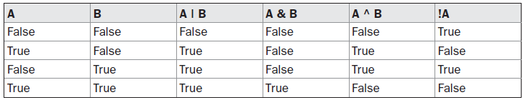
The logical Boolean operators, &, |, and ^, operate on boolean values in the same way that they operate on the bits of an integer.
Prepared by Renetha J.B.
24

Slide 25
// Demonstrate the boolean logical operators.
class BoolLogic {
public static void main(String args[]) {
boolean a = true;
boolean b = false;
boolean c = a | b;
boolean d = a & b;
boolean e = a ^ b;
boolean f = (!a & b) | (a & !b);
boolean g = !a;
System.out.println(" a = " + a);
System.out.println(" b = " + b);
System.out.println(" a|b = " + c);
System.out.println(" a&b = " + d);
System.out.println(" a^b = " + e);
System.out.println("!a&b|a&!b = " + f);
System.out.println(" !a = " + g);
}
}
a = true
b = false
a|b = true
a&b = false
a^b = true
a&b|a&!b = true
!a = false

Slide 26
Short-Circuit Logical Operators
Secondary versions of the Boolean AND and OR operators are known as short-circuit logical operators. || &&
A ||B
Here OR operator results in true when A is true, no matter what B is.
A&&B
Here, the AND operator results in false when A is false, no matter what B is.
If we use the || and && forms Java will not bother to evaluate the right-hand operand when the outcome of the expression can be determined by the left operand alone.
Prepared by Renetha J.B.
26

Slide 27
Short-Circuit Logical Operators(E.g)
E.g
if (denom != 0 && num / denom > 10)
Here if denom is 0 the second expression is not validated
  So there is no risk of causing a run-time exception when denom is zero.
If this line of code were written using the single & version of AND, both sides would be evaluated, causing a run-time exception when denom is zero.
Prepared by Renetha J.B.
27

Slide 28
Assignment Operator
var = expression;
Here, the type of var must be compatible with the type of expression.
It allows you to create a chain of assignments
int x, y, z;
x = y = z = 100; // set x, y, and z to 100
Prepared by Renetha J.B.
28

Slide 29
Ternary (conditional or three-way) operator
The ? Operator has this general form:
expression1 ? expression2 : expression3
Here, expression1 can be any expression that evaluates to a boolean value.
  If expression1 is true, then expression2 is evaluated; otherwise, expression3 is evaluated.
  The result of the ? operation is that of the expression evaluated.
  Both expression2 and expression3 are required to return the same type, which can’t be void
Prepared by Renetha J.B.
29

Slide 30
E.g.
int ratio = denom == 0 ? 0 : num / denom;
  If denom equals zero, then the expression between the question mark and the colon is evaluated and used as the value of the entire ? expression.
    Here 0 is stored in ratio
  If denom does not equal zero, then the expression after the colon is evaluated and used for the value of the entire ? expression.
  i.e num/denom is stored in ratio
The result produced by the ? operator is then assigned to ratio.
Prepared by Renetha J.B.
30

Slide 31
int a=3,b=5;
int c=(a>b?a:b);
Here a>b is false so the value of b is stored in c.
Prepared by Renetha J.B.
31

Slide 32
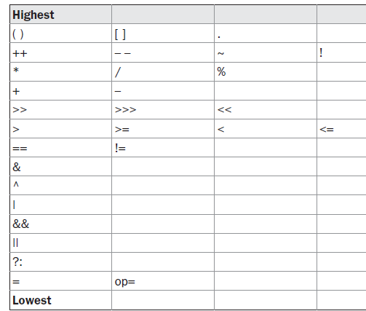
Operator Precedence
Prepared by Renetha J.B.
32

Slide 33
Associativity of operators
When an expression has two or more operators with the same precedence, the expression is evaluated according to its associativity.
  It is the order of applying operators
Prepared by Renetha J.B.
33

Slide 34
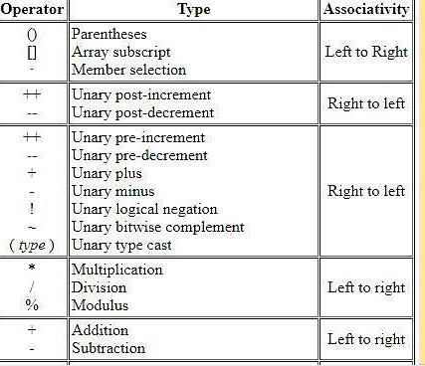
Operator Associativity
Prepared by Renetha J.B.
34

Slide 35
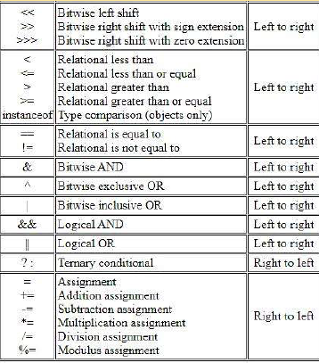
Prepared by Renetha J.B.
35

Slide 36
Associativity
Right to Left associative
  Unary operators
  Assignment operators
  Conditional(ternary) operators)
All other operators are Left to Right associative
Prepared by Renetha J.B.
36

Slide 37
Reference
Herbert Schildt, Java: The Complete Reference, 8/e, Tata McGraw Hill, 2011.
Prepared by Renetha J.B.
37

